Slide 1

Kilifi SCHMT Meeting ARL-Low Birth Weight Infant Study 10 Nov 2025 Prepared and presented by; ARL-LBW team

Slide 2
Agenda
Opening remarks
Study progress updates
Main discussion
Peer mother recruitment
Closing remarks

Slide 3
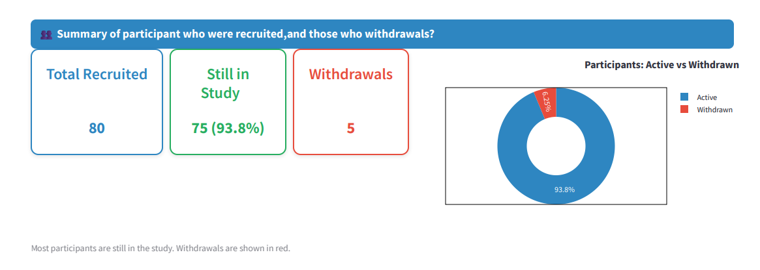
Study progress

Slide 4
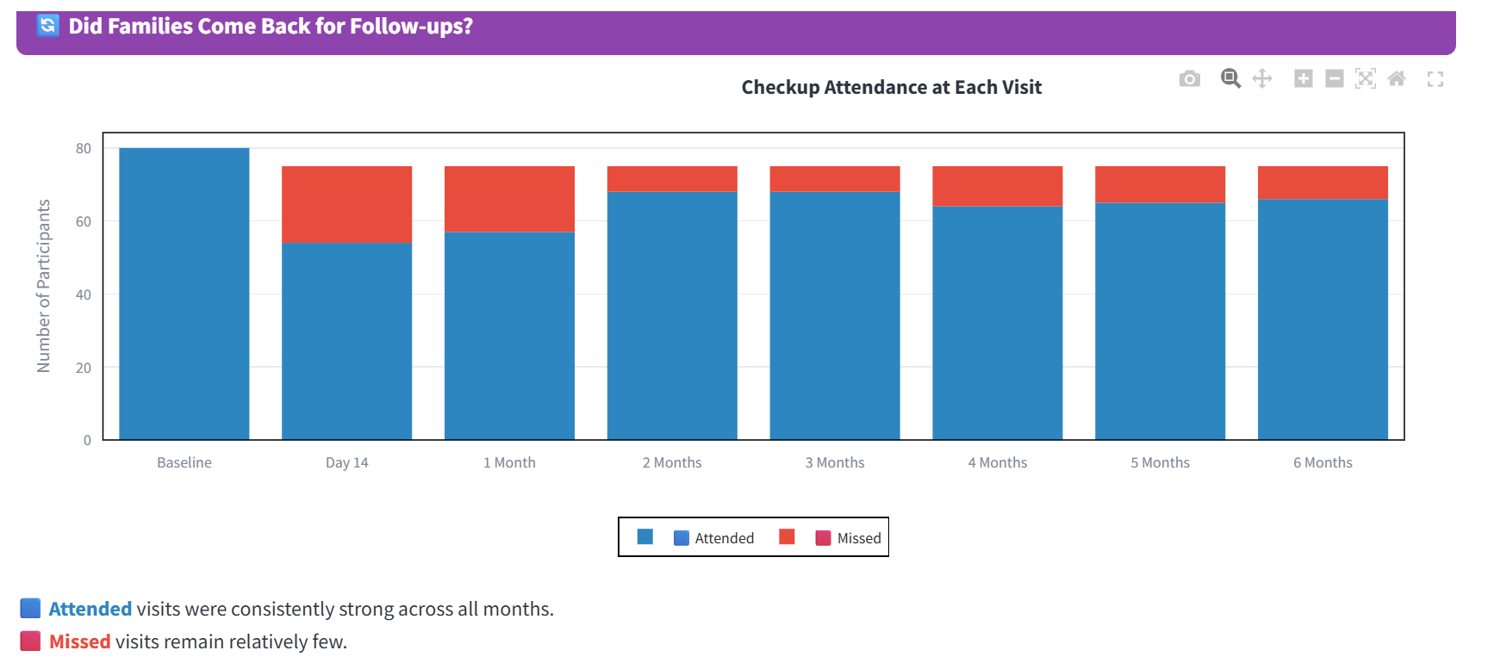
Study progress cont’d…

Slide 5
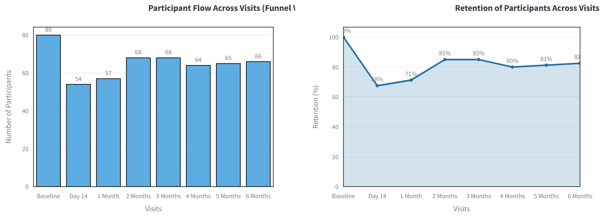
Study Progress – Control Group Recruitment & Follow-up
Key Takeaway: Recruitment nearly complete. Retention remains strong until Month 3, slight drop in month 4

Slide 6
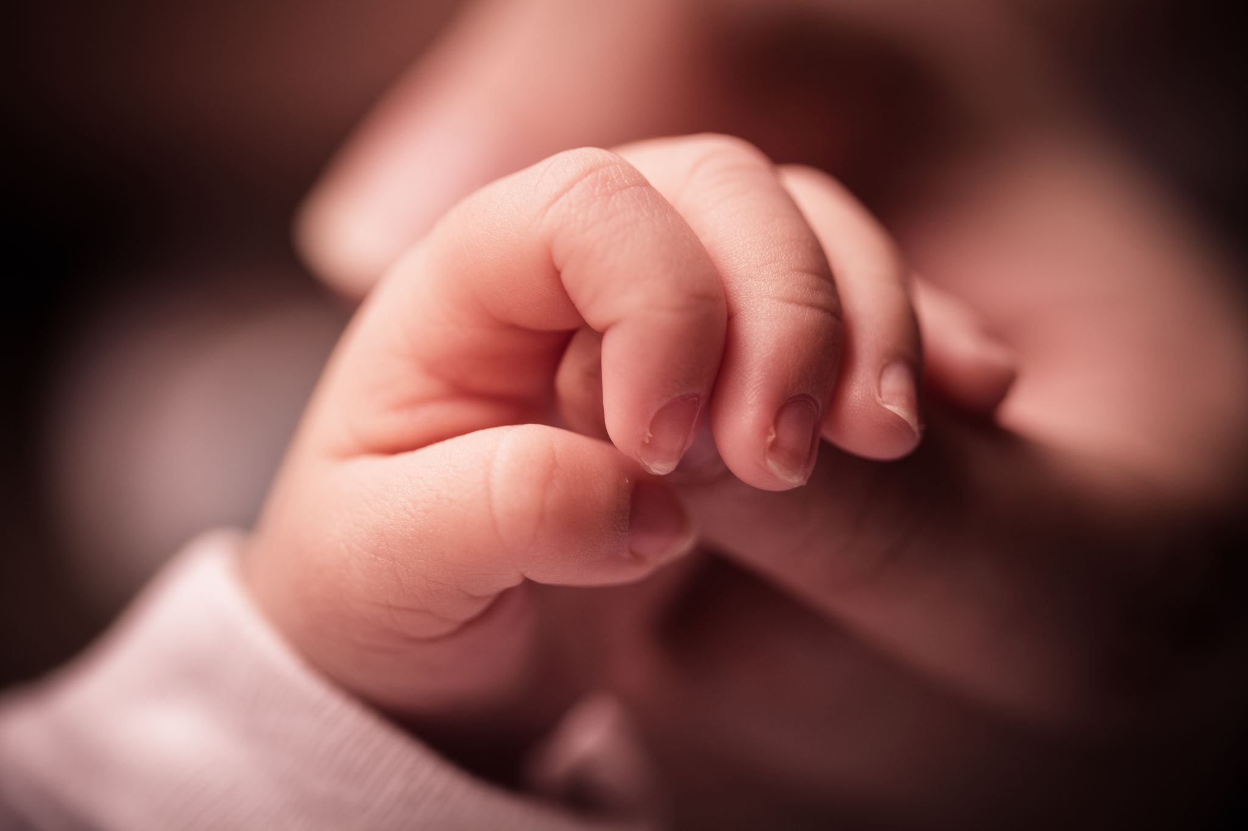
Who can be a peer mother?.....
Experience
Cared for a LBW infant
Community breastfeeding champion
Motivation
Volunteer to support mothers of LBW infants
Literacy
Able to read and write
Age
Minimum age 15 years
Role and supervision
Ratio of 1 peer mother : 2-3 LBW mothers

Slide 7
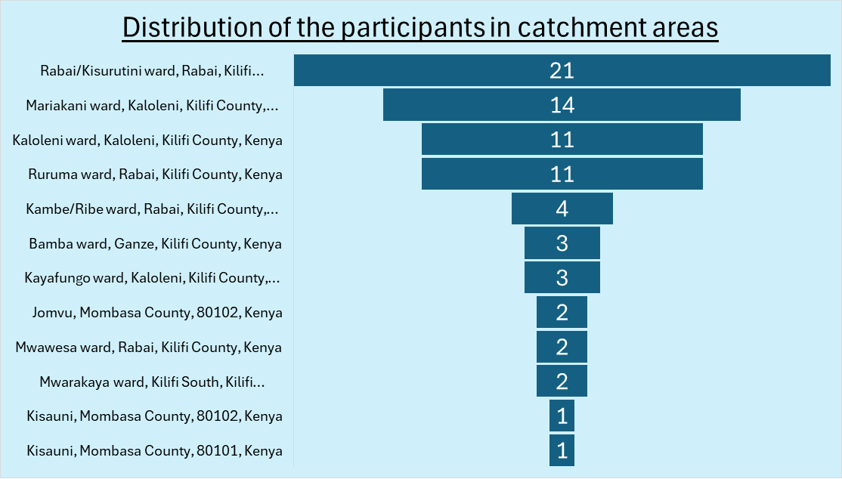
Peer mother recruitment
Peer mother recruitment process;
Use of GPS data coordinates collected during baseline for control group
Collaboration with the CHP leadership team in the catchment area
Health records.

Slide 8
Peer mother selection
Recruitment
1
60 potential peer mothers selected for training
- CHPs will join the training
Competency test
Training
2
3
Assessed through role plays
Knowledge assessment
📚 10-day training
Communication skills
psychological support
Health promotion interventions
Interventions for sick infants
.
4
Final selection
- 50 peer mothers .

Slide 9
Discussion
Recruitment
What adjustments can strengthen our recruitment approach?
How do we balance between recruiting experienced mothers of LBW infants vs community breastfeeding champions?
What strategies can we use to ensure sustainability and reduce drop-outs among peer mothers?

Slide 10
Discussion cont’d…
Timing & linkage with participants
Should peer mother linkage with participants happen at the facility or later in the community?
What are the pros and cons of linking at the facility vs at home?
How do we ensure families accept and trust the peer mother at first contact?

Slide 11
Discussion cont’d…
Role of CHPs
How can we define clear roles between CHPs and peer mothers to avoid duplication?
What structures (supervision, reporting, joint visits) will best support collaboration between CHPs and peer mothers?

Slide 12


